Slide 1
7 – Clean Code – Architecture
Based on the CleanCoders videos by Uncle Bob Martin
Rupert Waldron

Slide 2
What is the architecture?
The architecture of a library should scream library
A good architecture should scream it’s intent at you
A good architecture is all about how it is being used…. A good architecture screams use-cases.
If all you can see is model-view-controller (MVC), then the architecture is hiding the use-cases and exposing the delivery mechanism. We don’t want the use-cases to know anything at all about the delivery mechanism.
Decisions on the databases, delivery mechanisms, UI etc. should be completely independent of the use-cases.

Slide 3
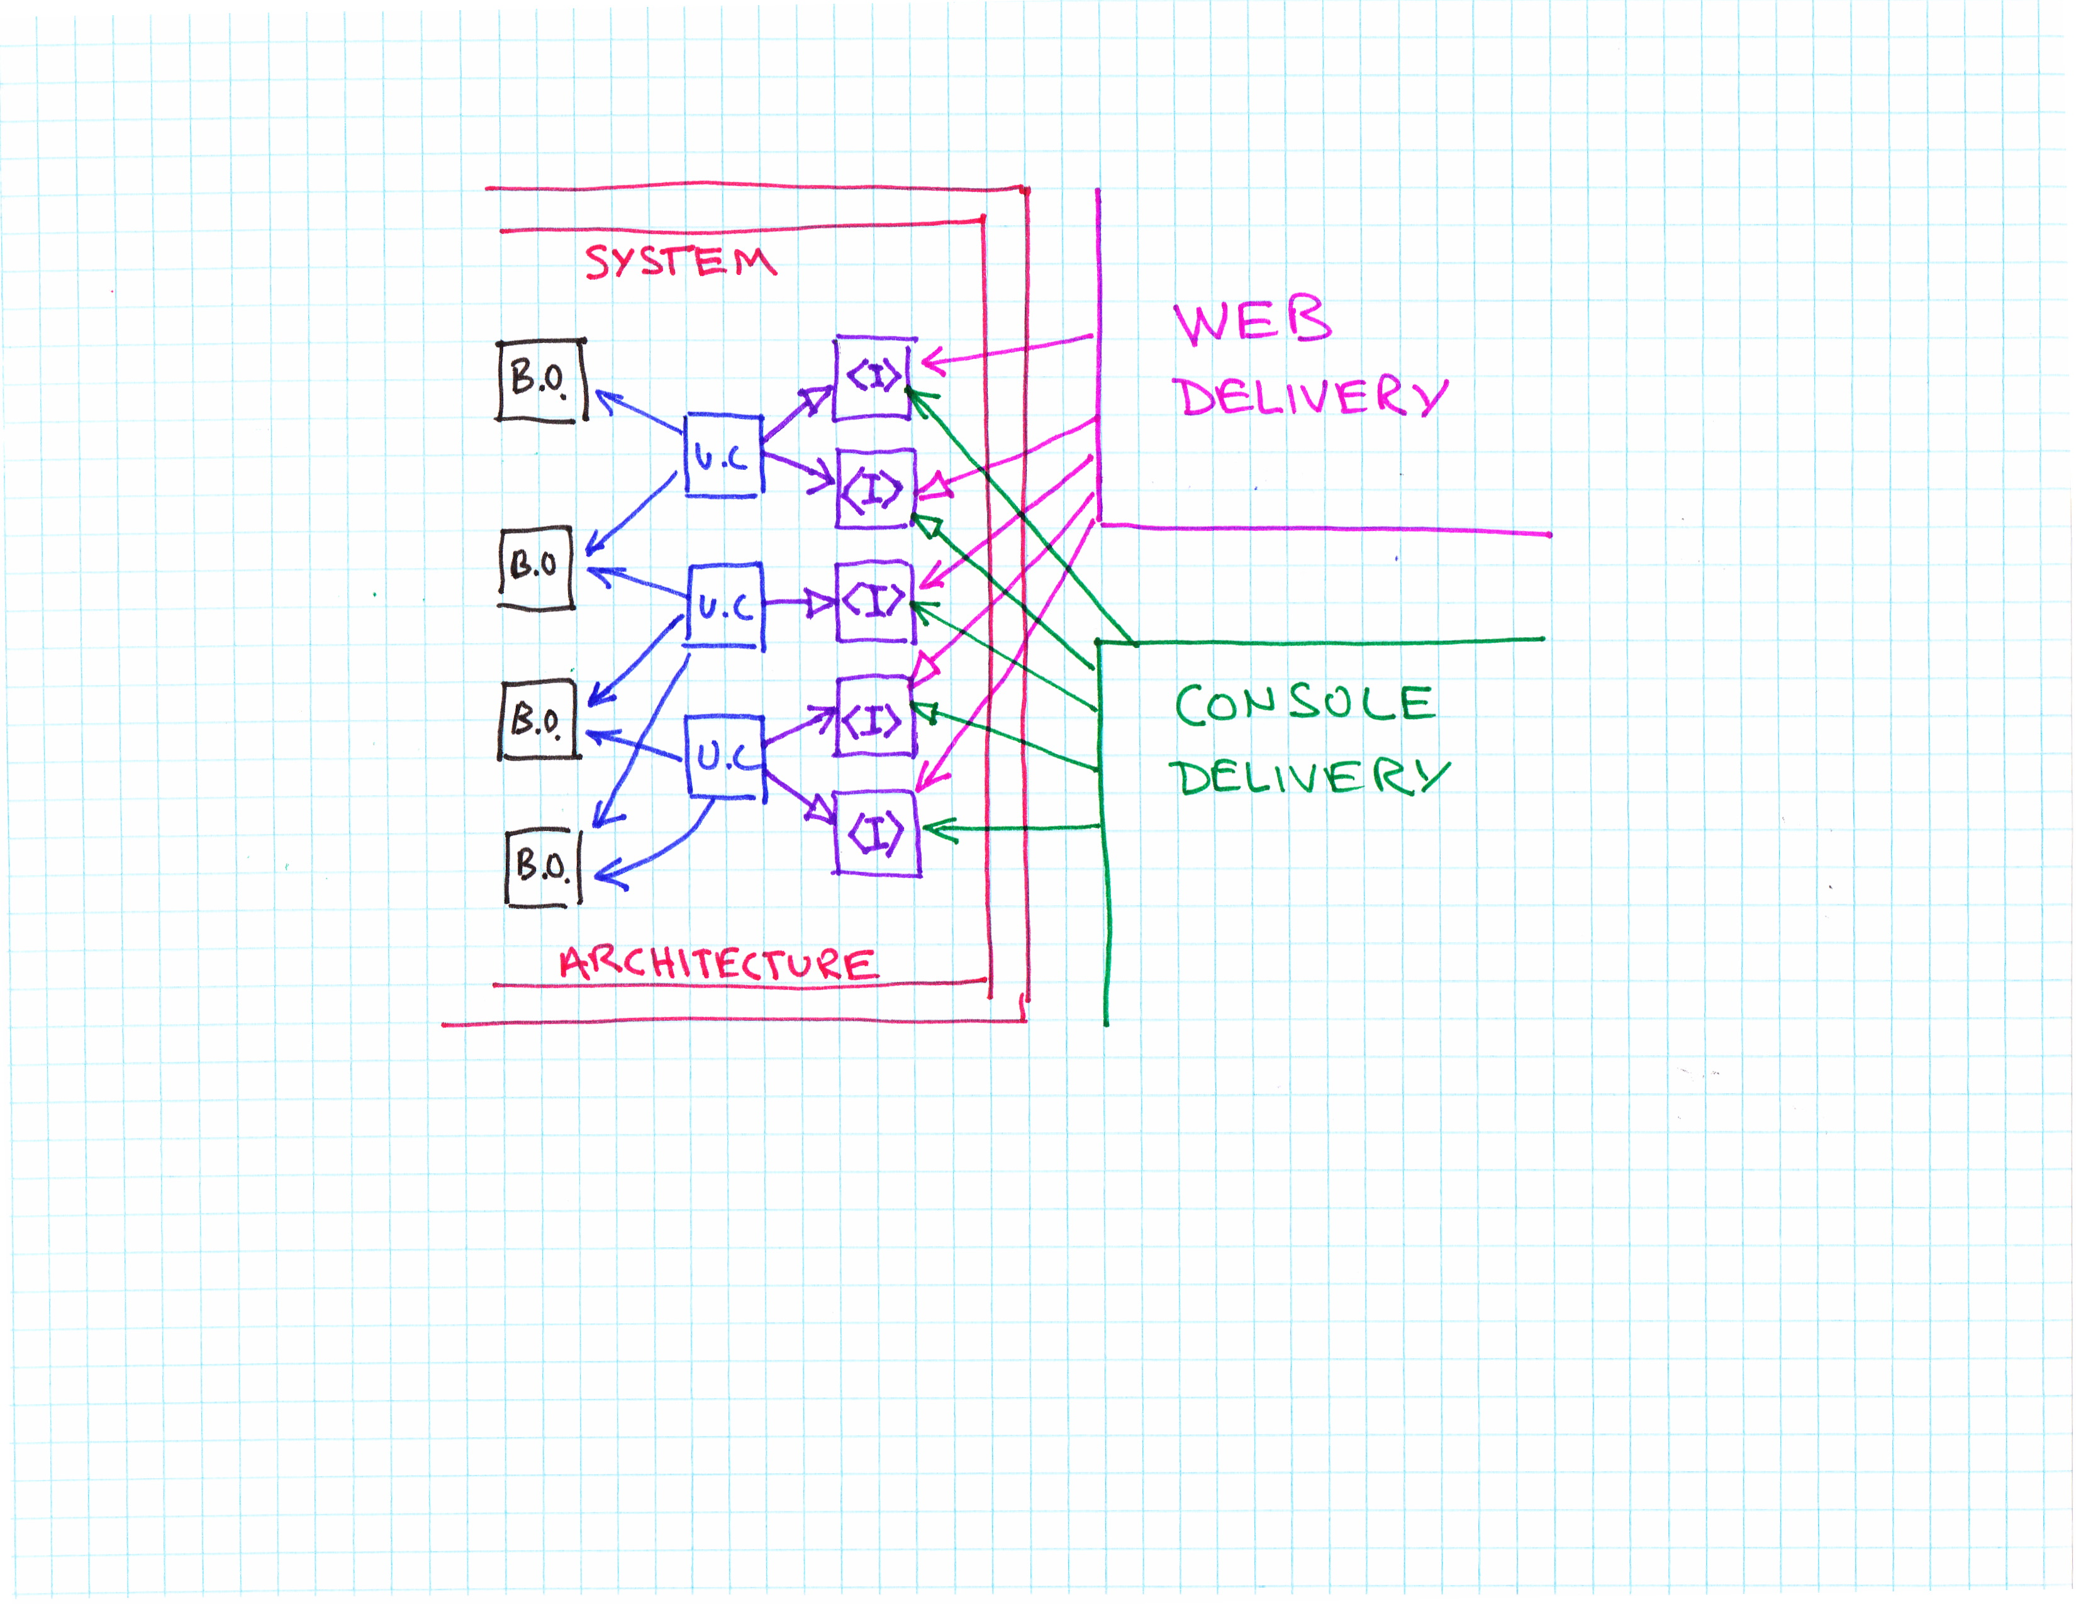
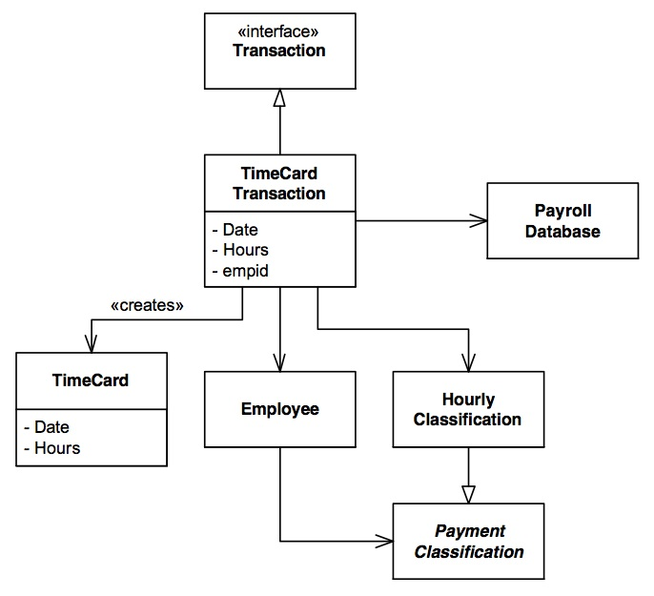
Use-Cases
The architecture is focused on the use-case, not the delivery mechanism, which is incidental.
You should see the intent of the system - payroll

Slide 4
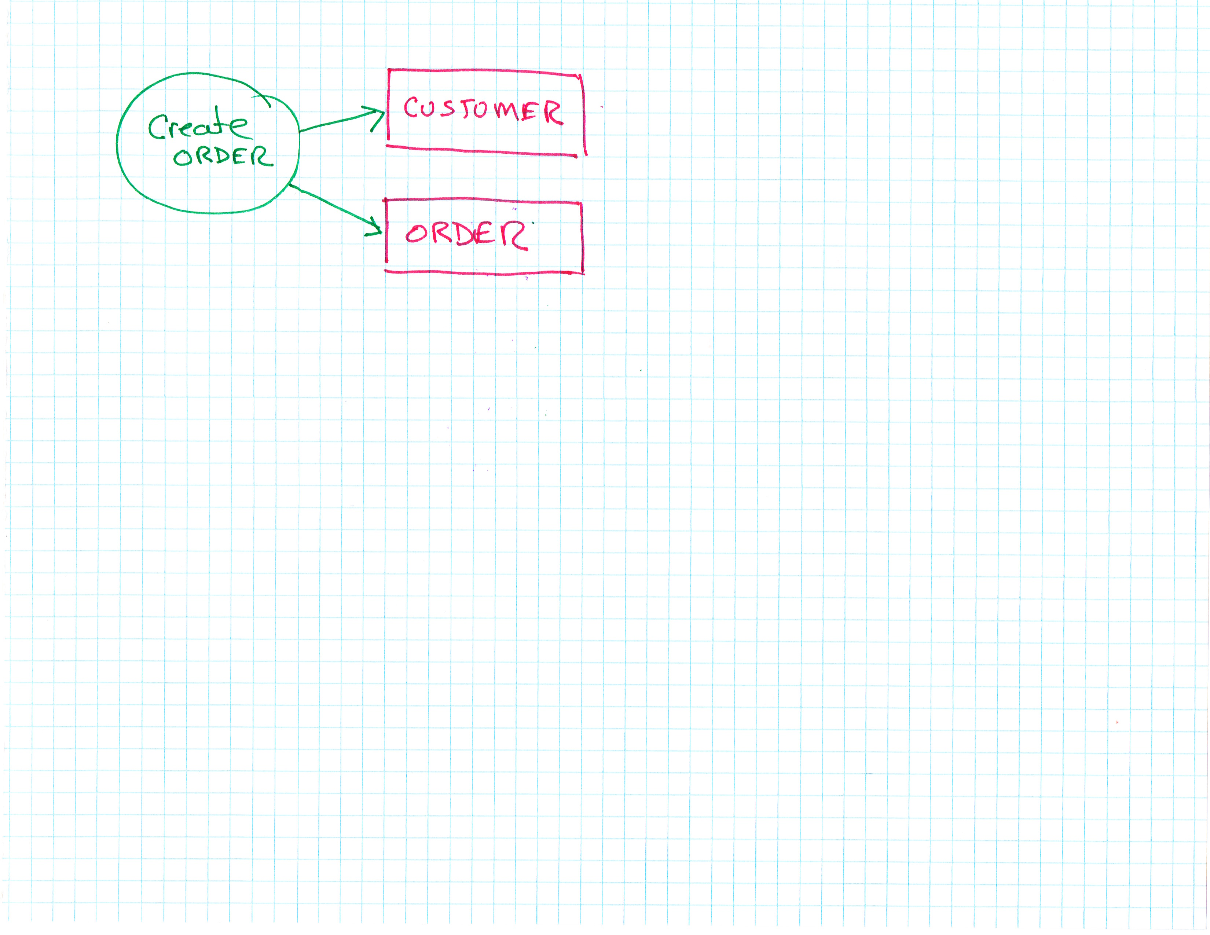
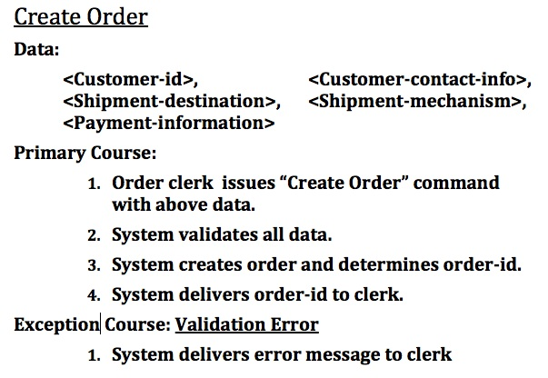
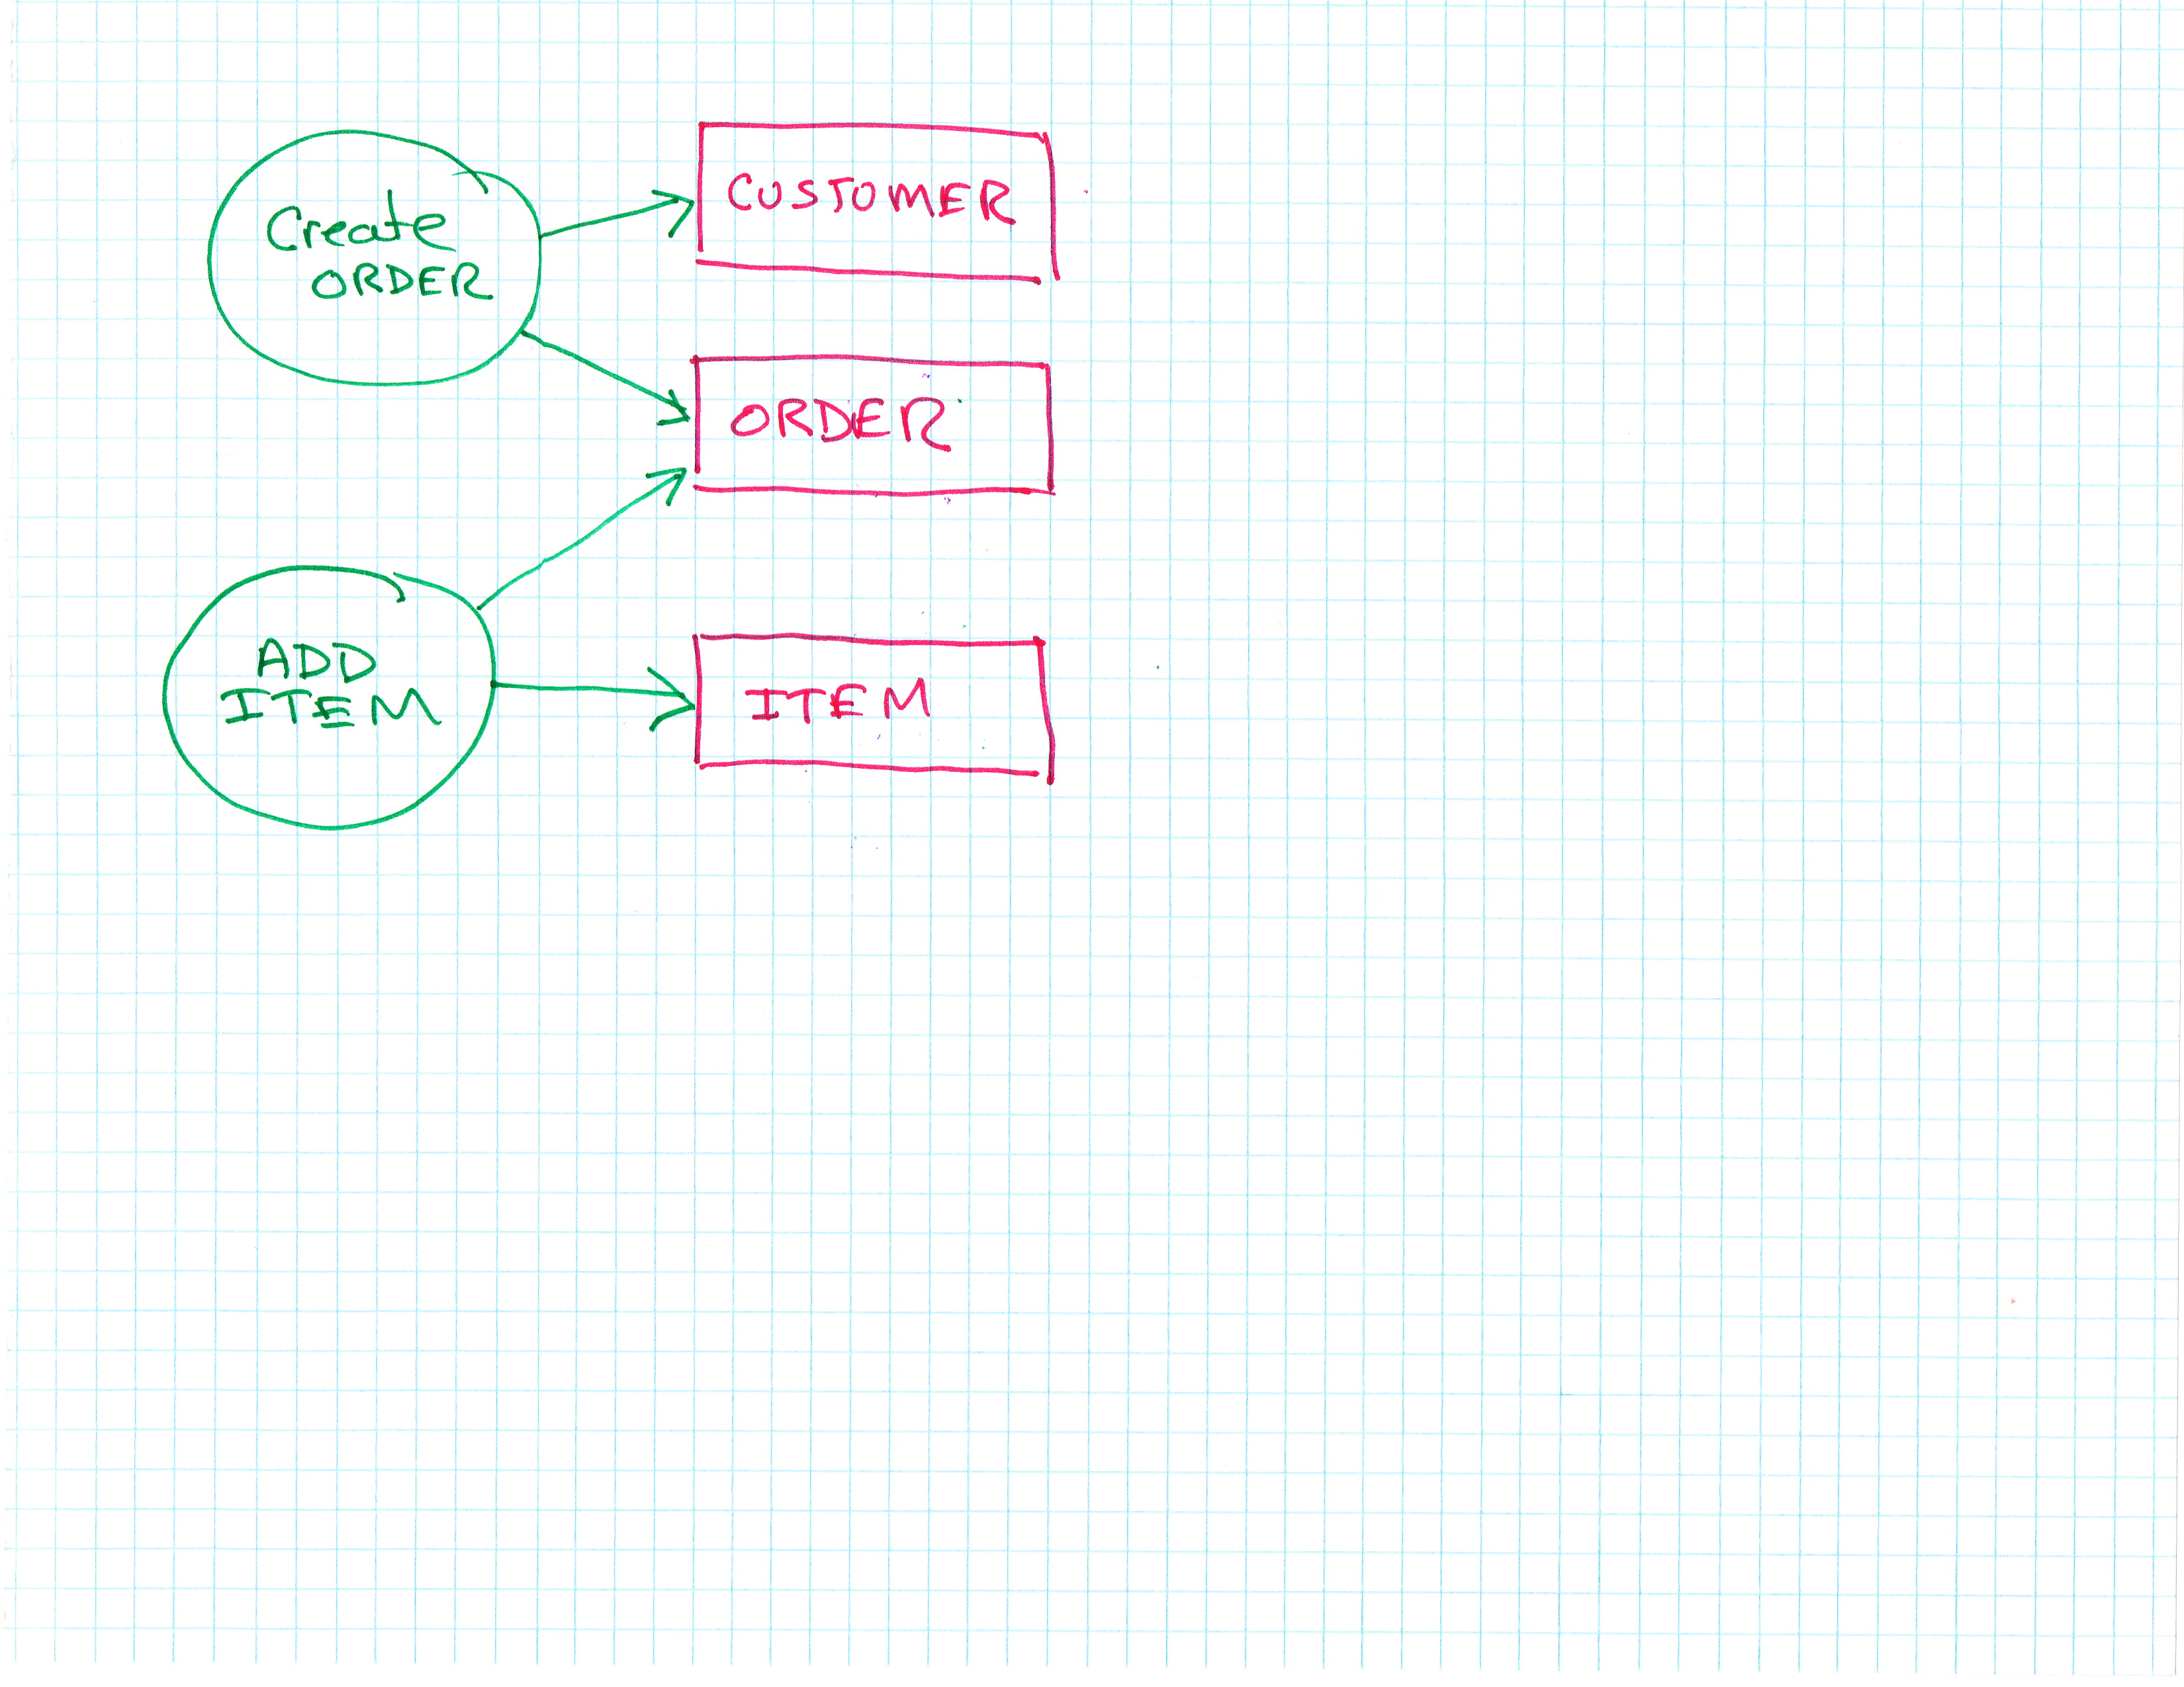
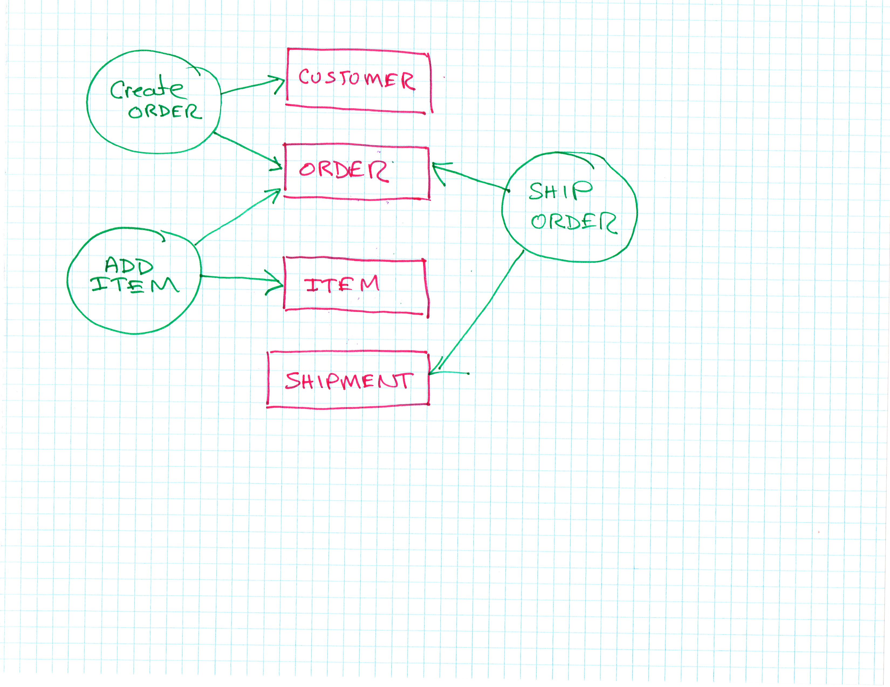
So what is a use-case?
Use-case definition: A formal description of how a user interacts with a system to achieve a specific goal.
How do we partition our app so that the use-cases become the central organizing principle?

Slide 5
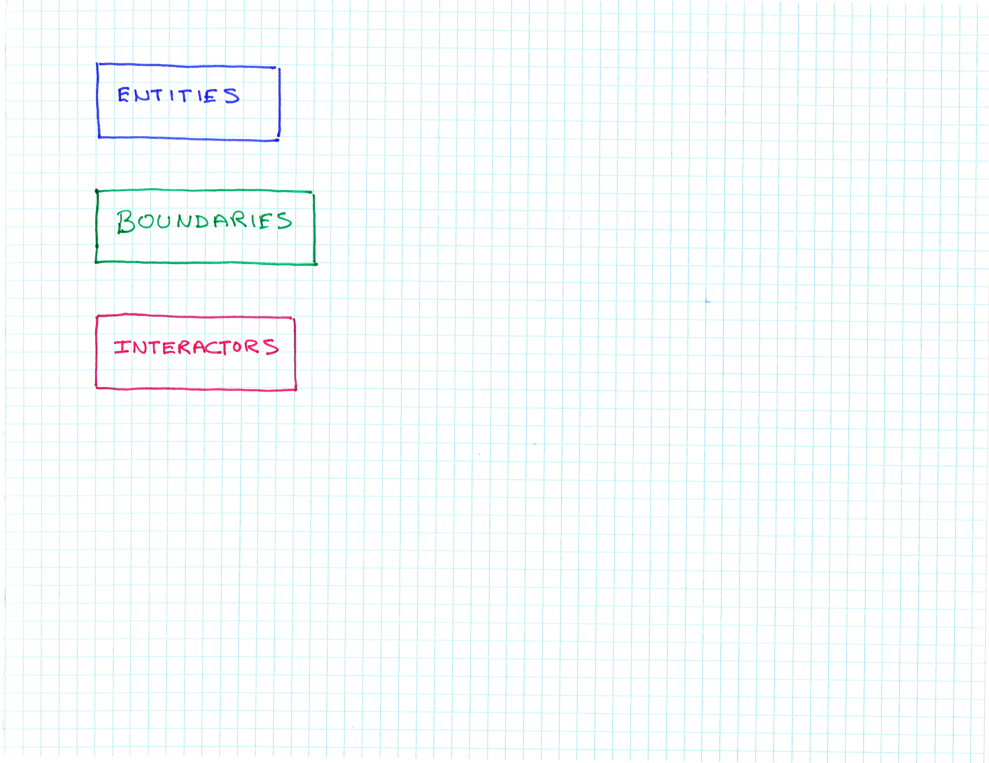
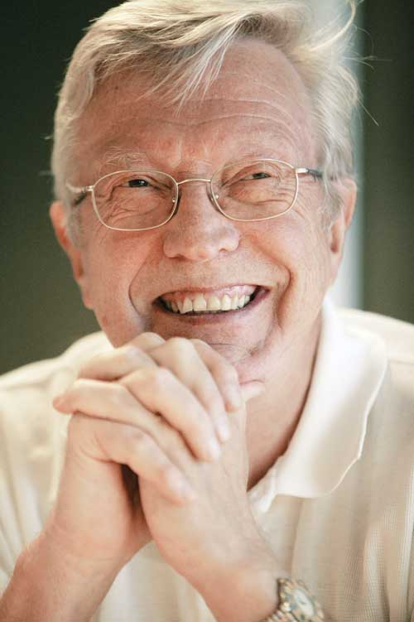
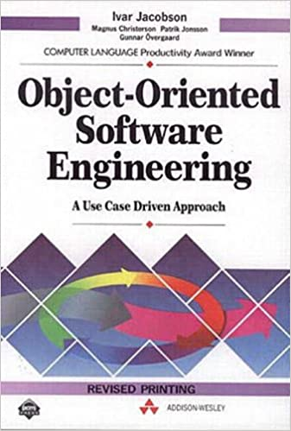
Partitioning
There are 3 fundamental types of object:
Business Objects – application independent business rules and have no application specific methods E.g. Pet
User Interface Objects -
Use-case Objects – Use-cases are application and hence therefore are interactors. E.g. Petstore

Slide 6
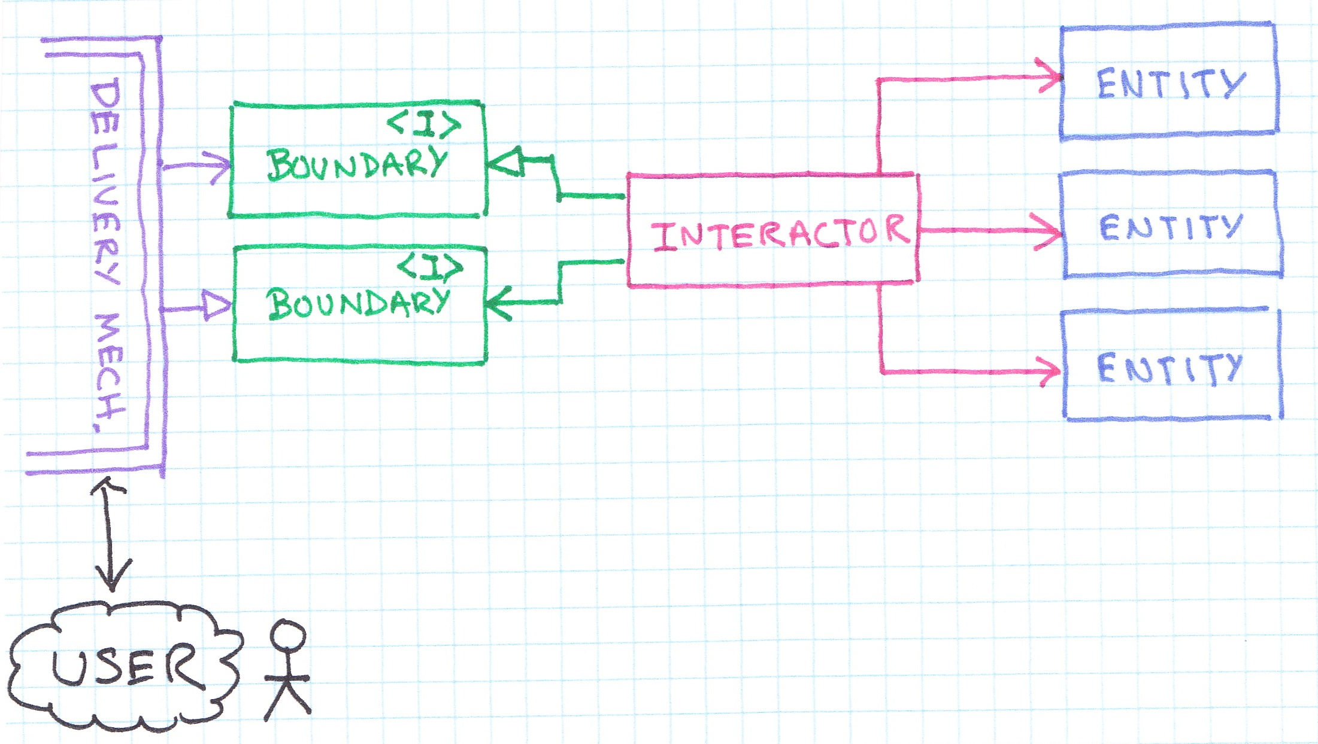
PetStore
Application Agnostic Entities – Pet could be used in different applications
PetShopOwnerRequest
Pet
PetShop Input
Petstore Interactor
PetFactory
Terminal Output
Use-Cases
OutputPort
The Petstore Interactor is independent of delivery mechanisms
The Entities no nothing about the rest of the system
Deliver mechanism is isolated by the boundary
The entities and interactors don’t know anything about any framework and so can be tested without it

Slide 7
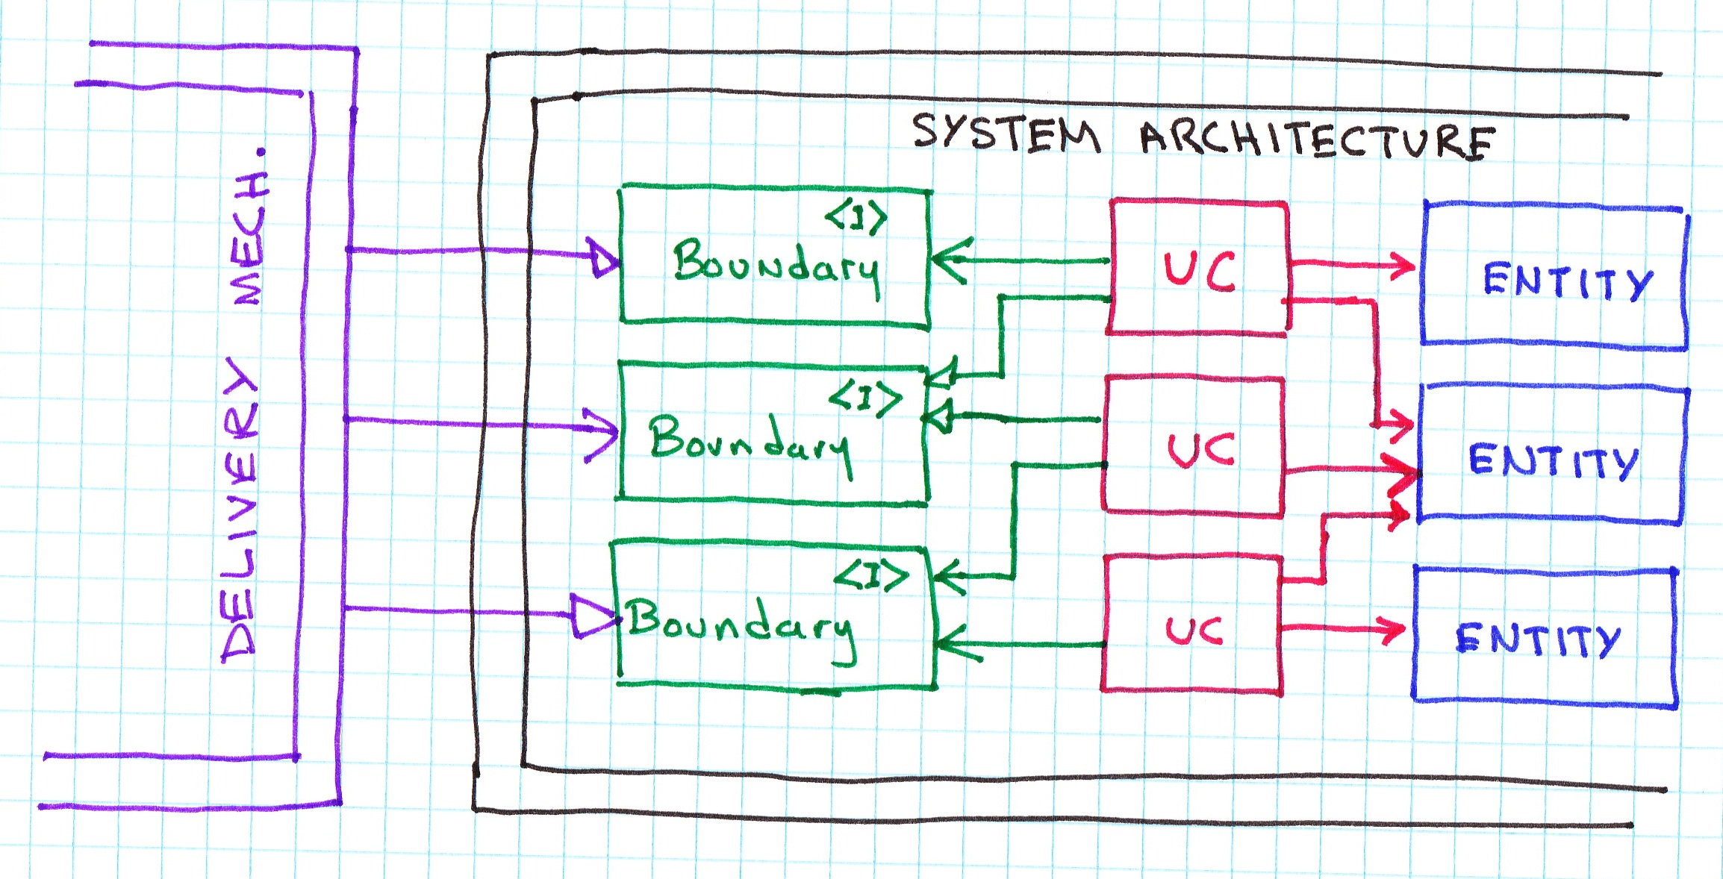
Isolation

Slide 8
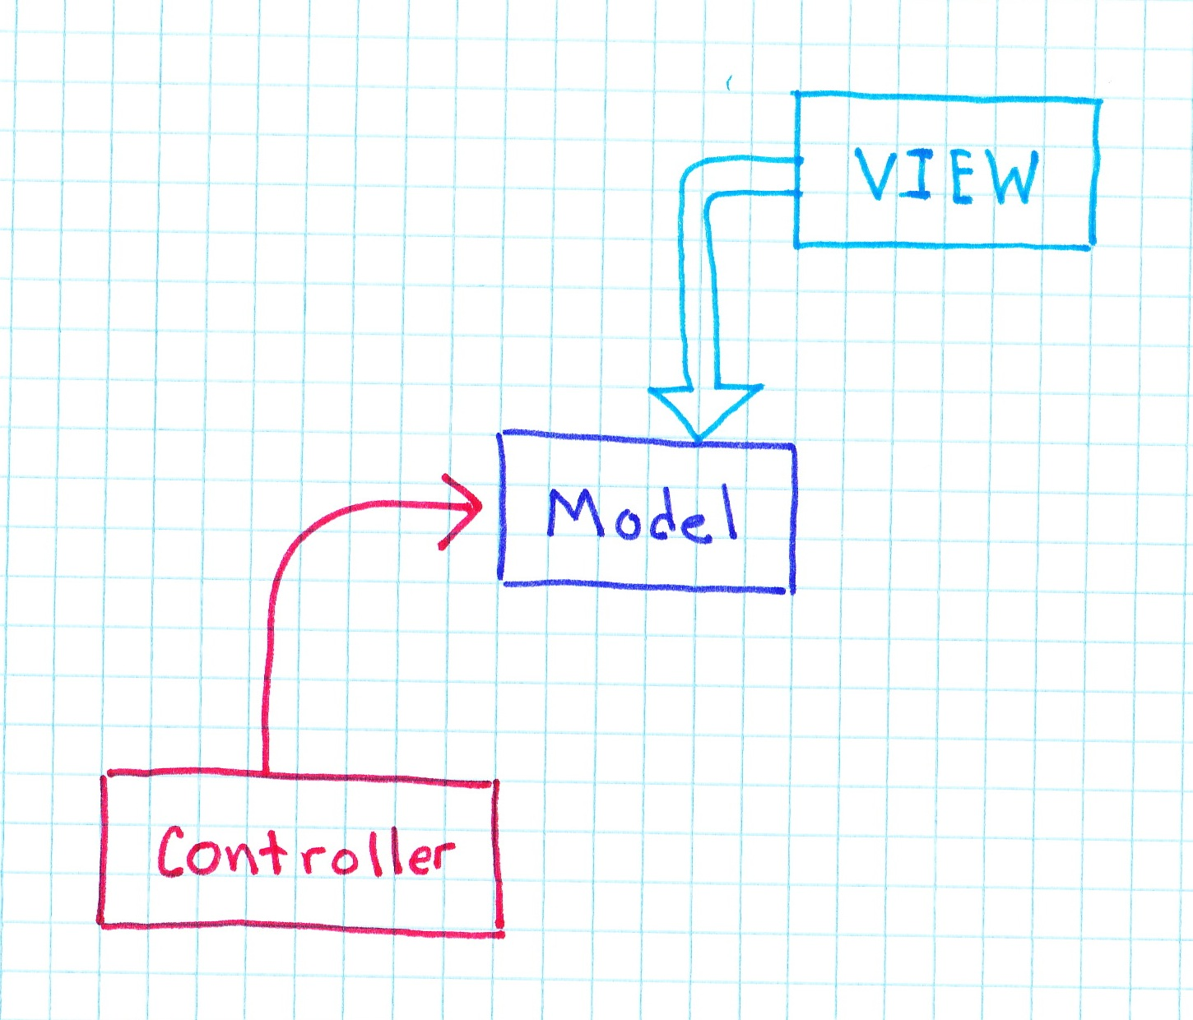
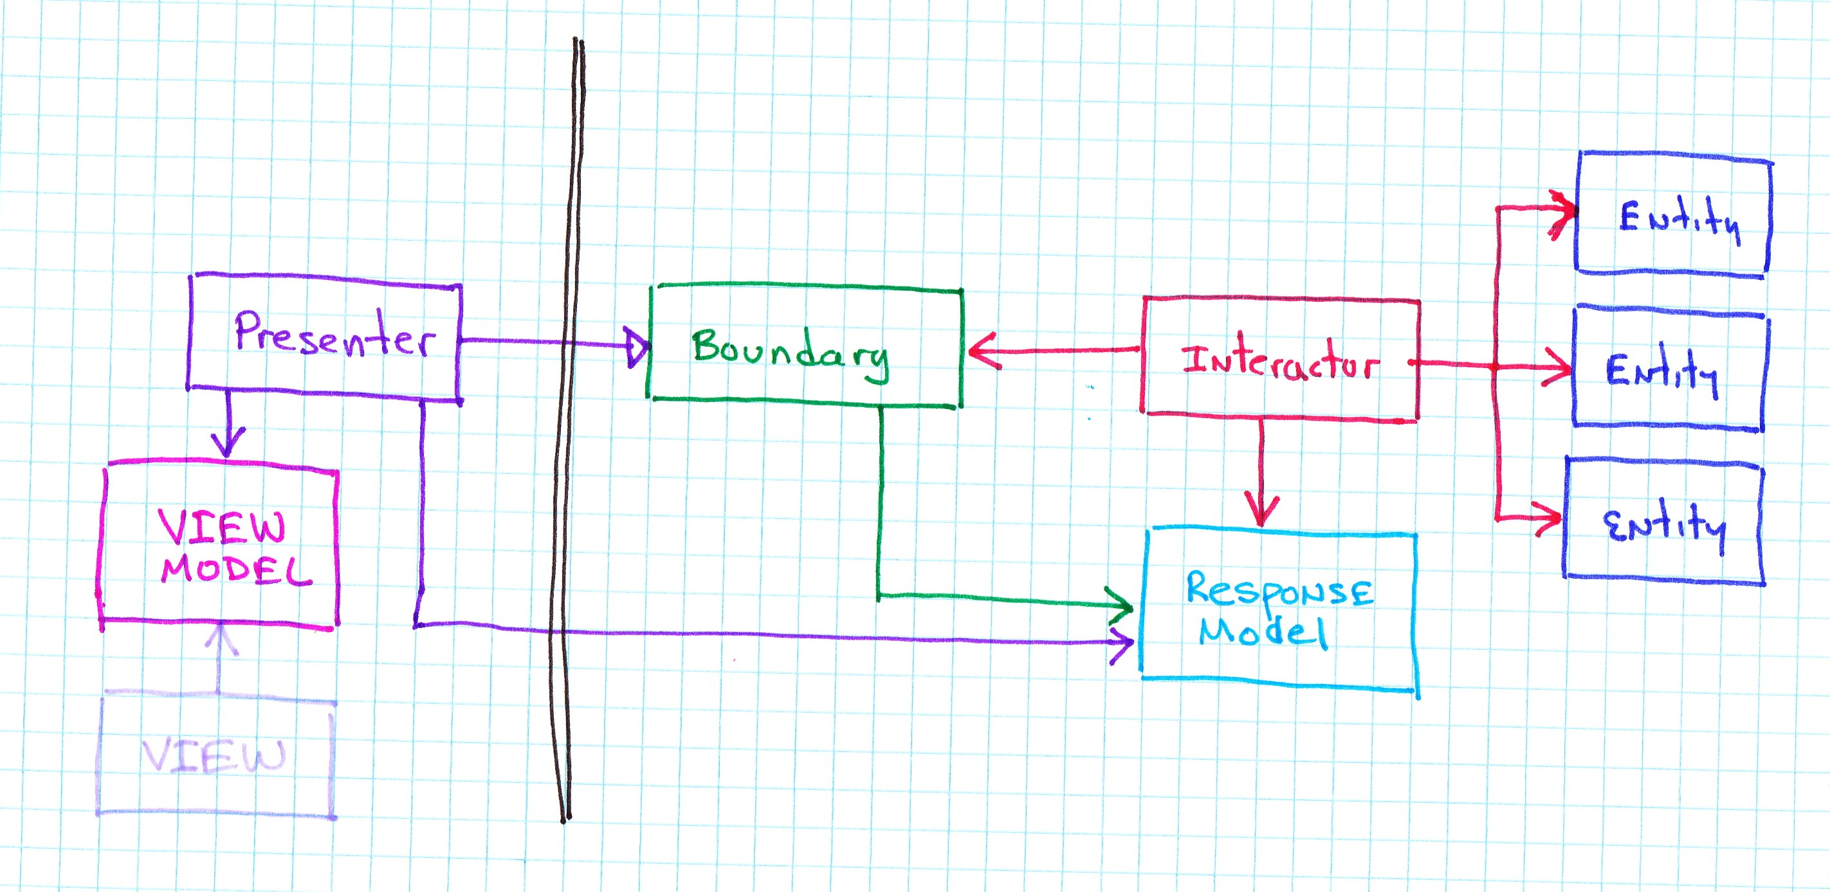
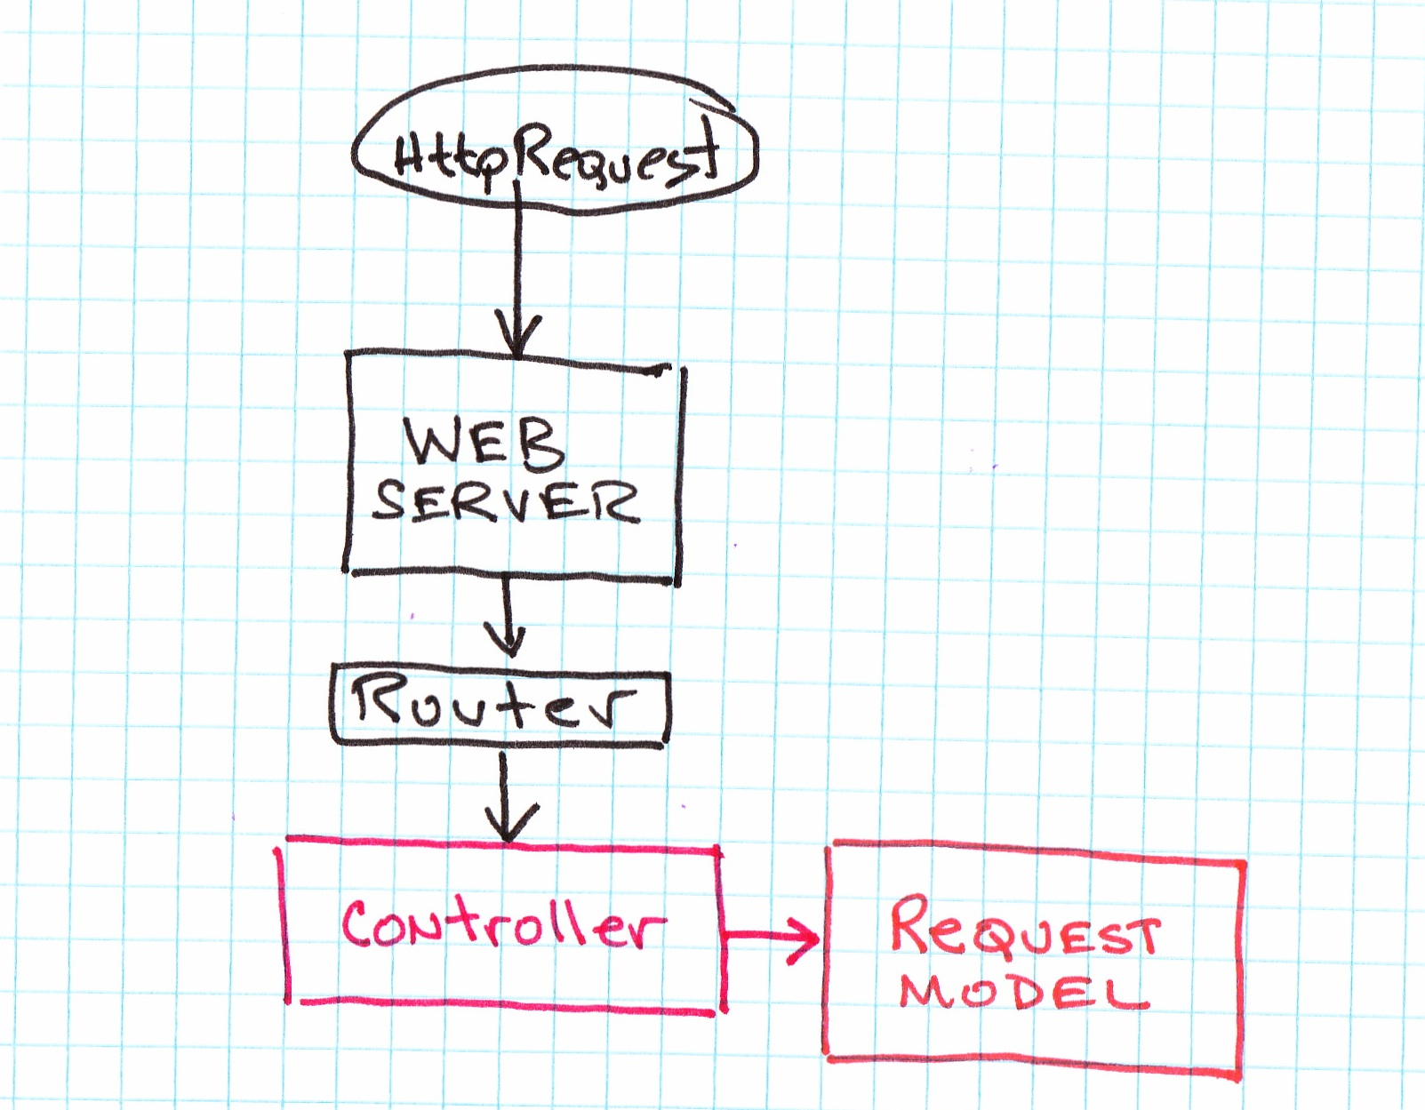
Model View Controller
As First Invented
As Used now
View can no longer be extended from simple business objects
Model used to be business objects

Slide 9
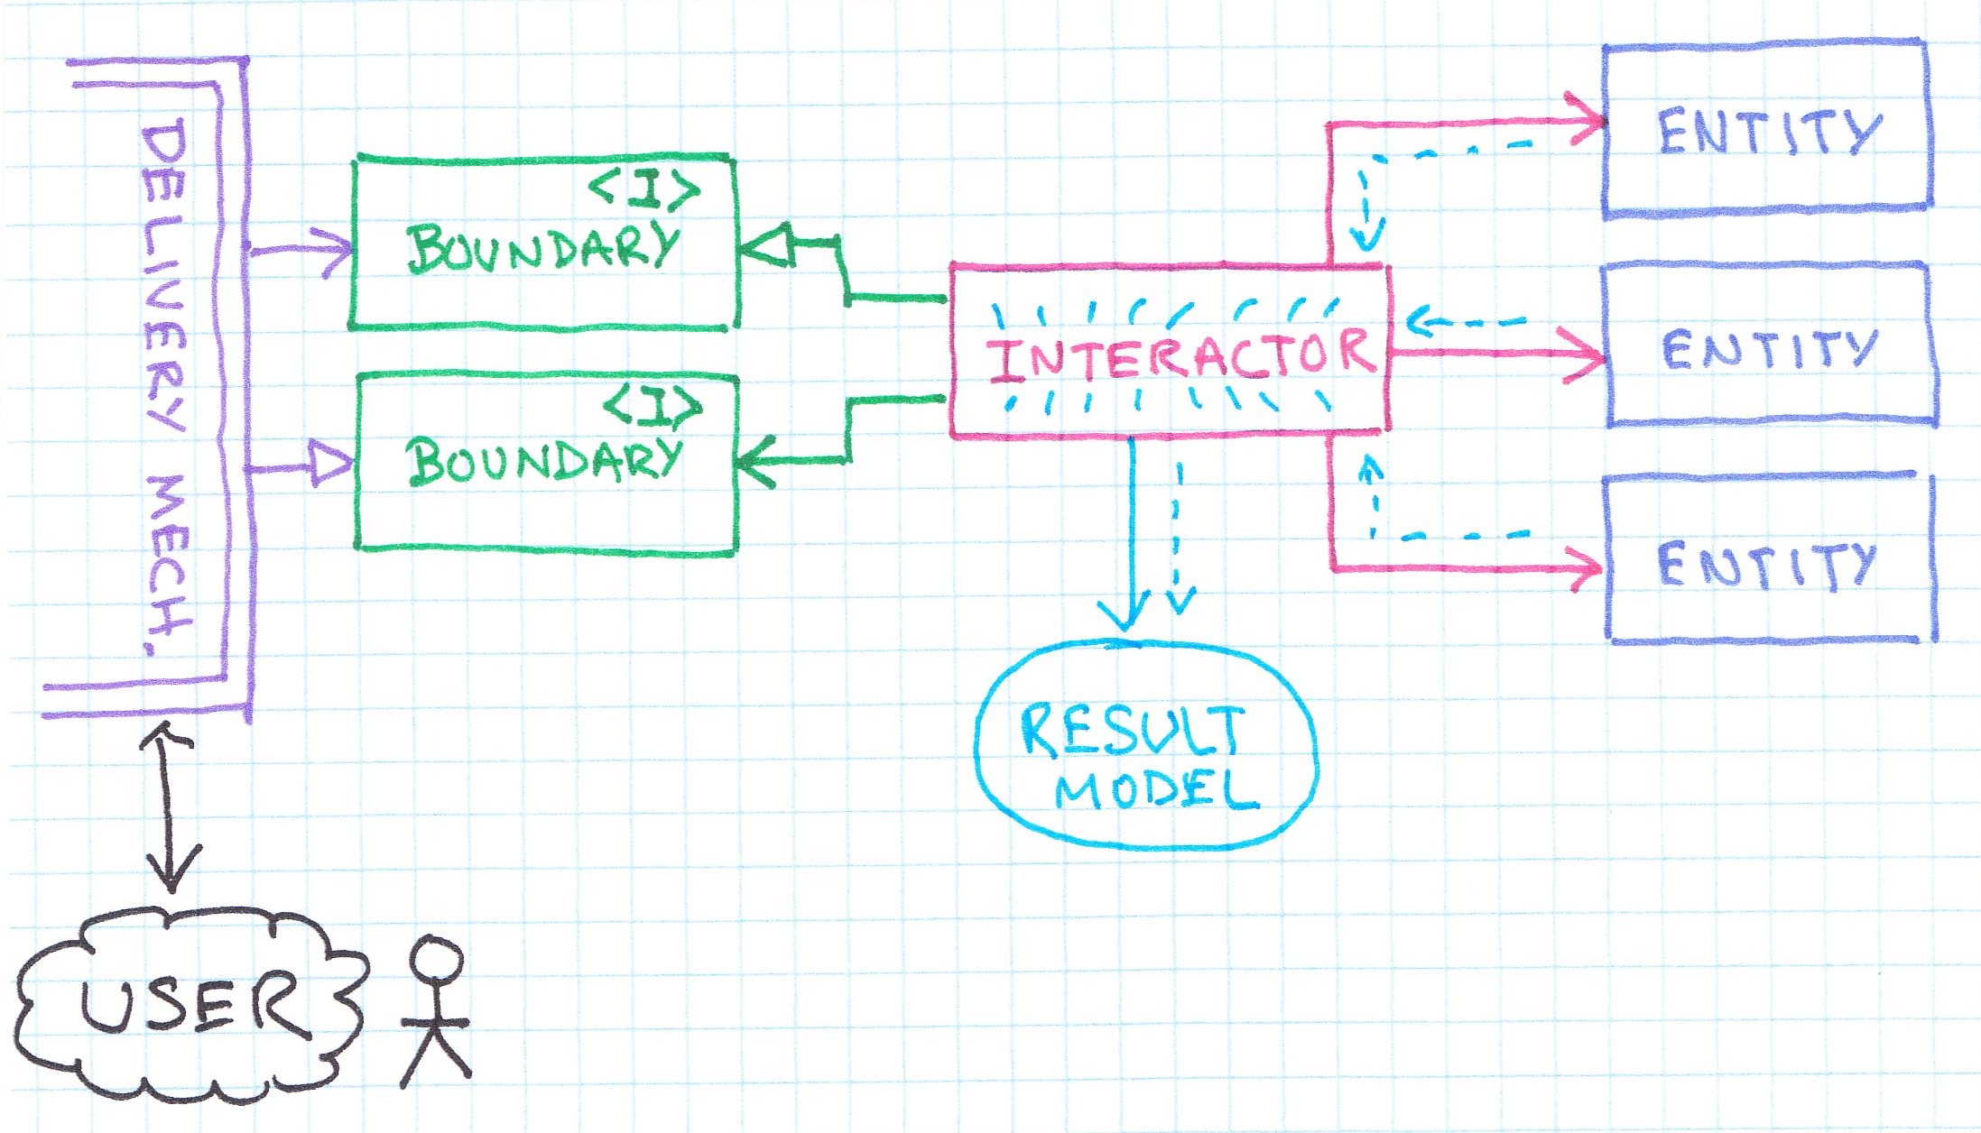
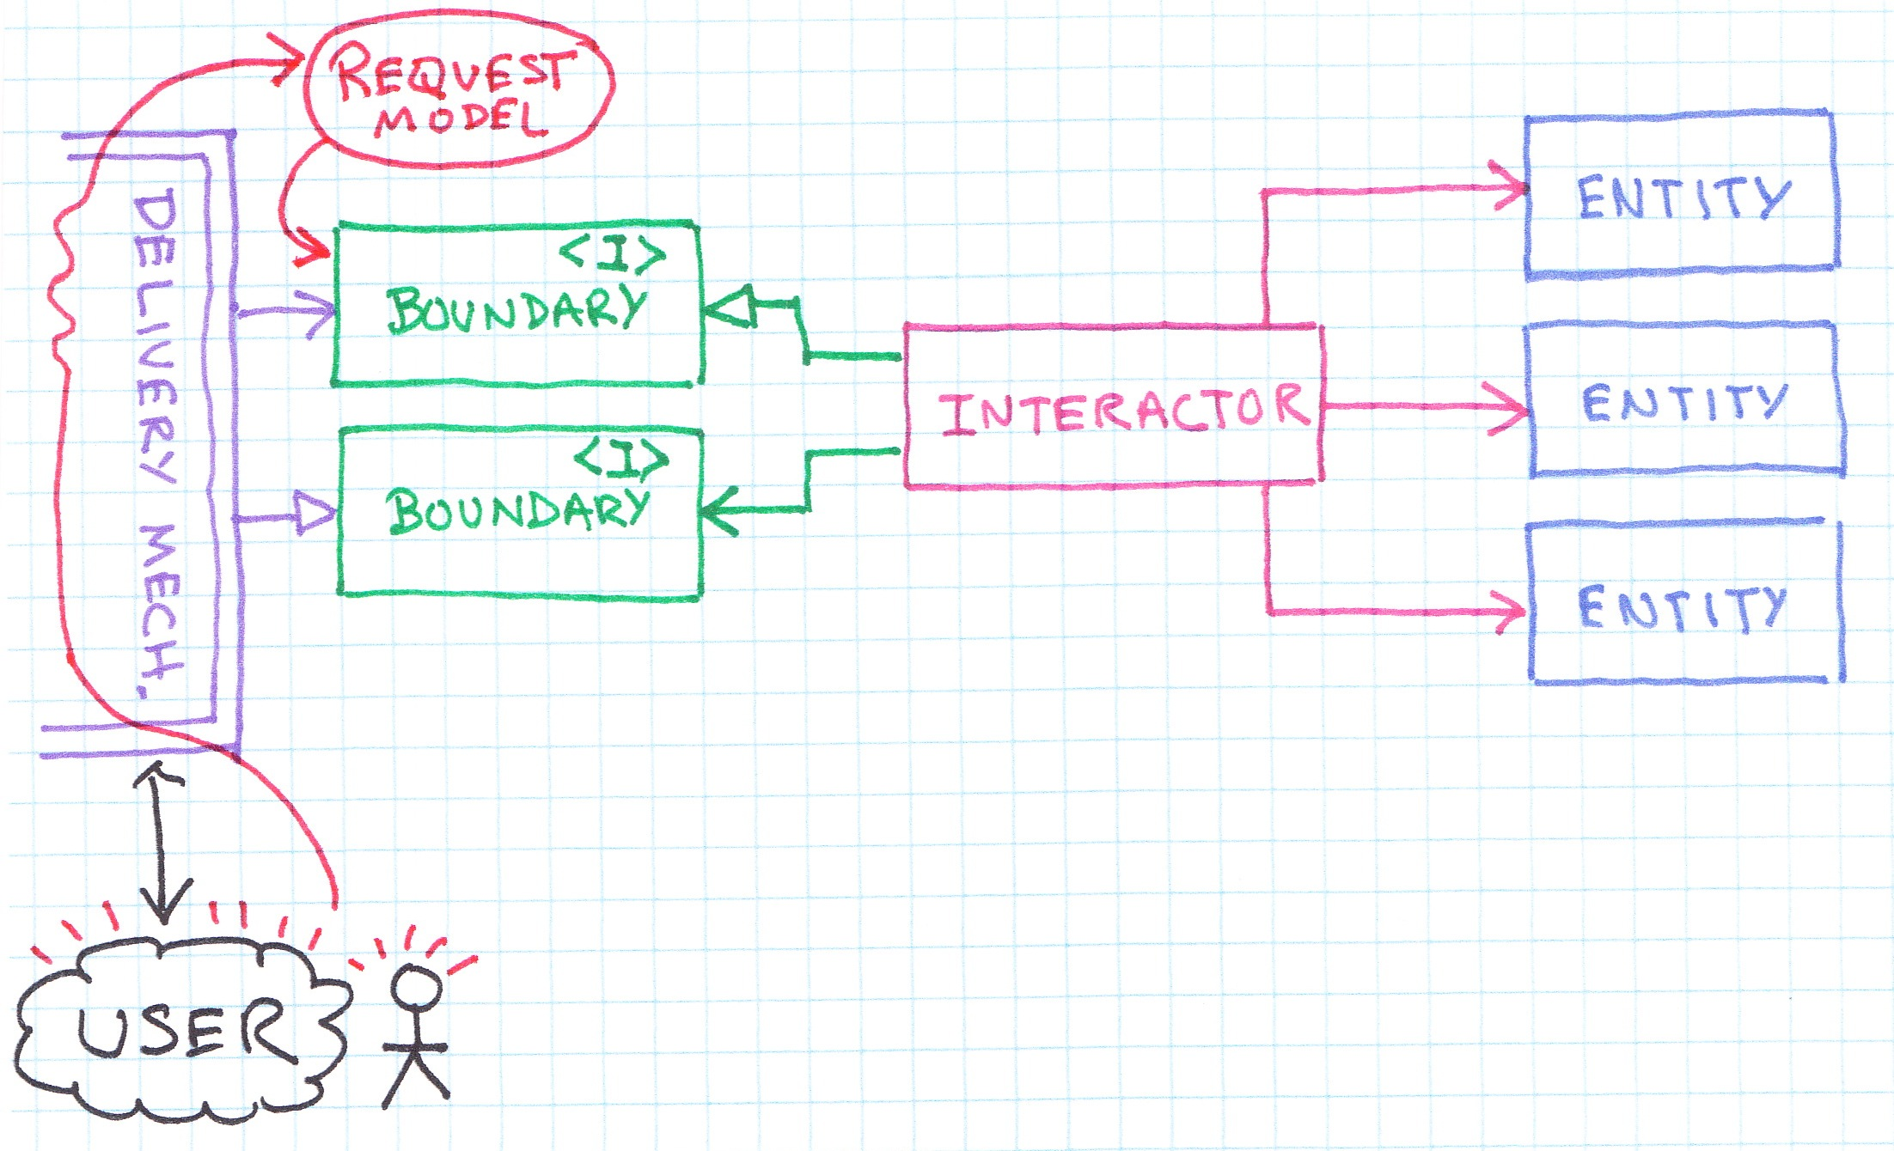
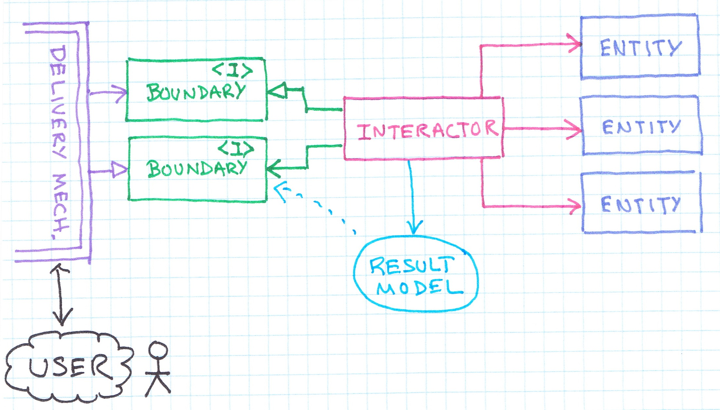
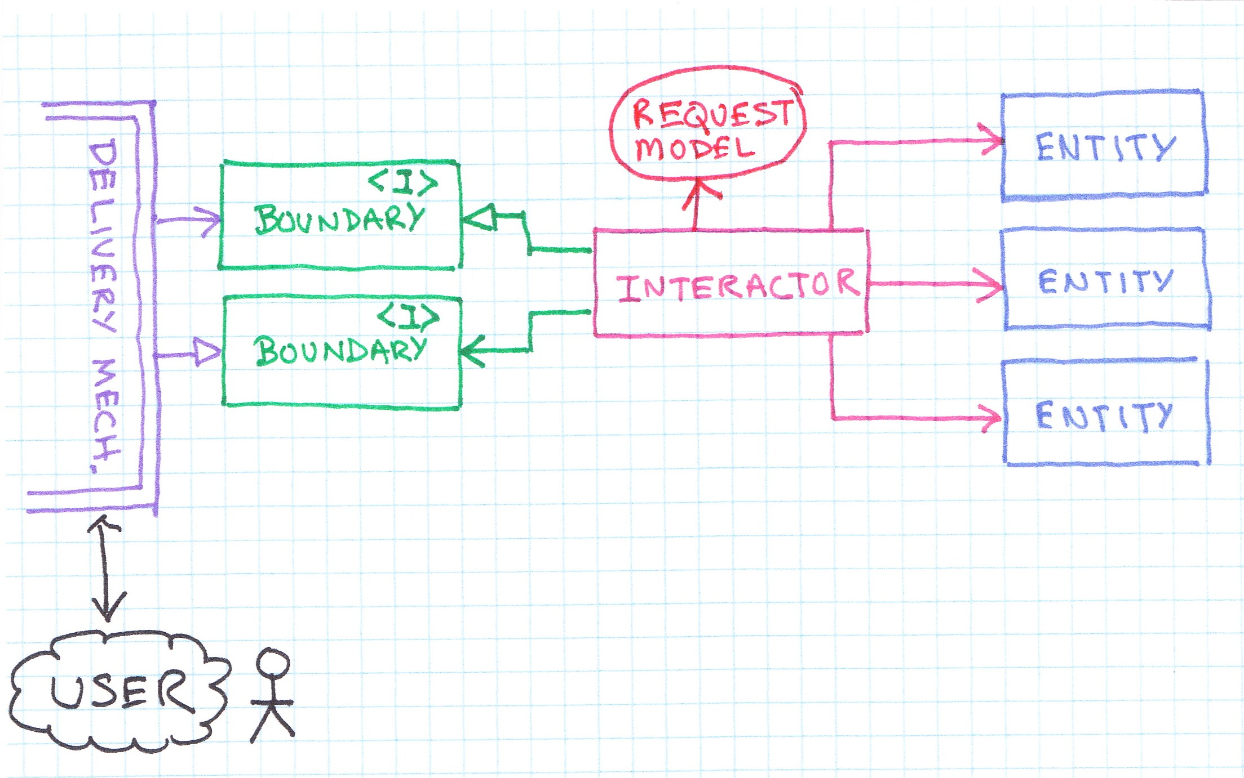
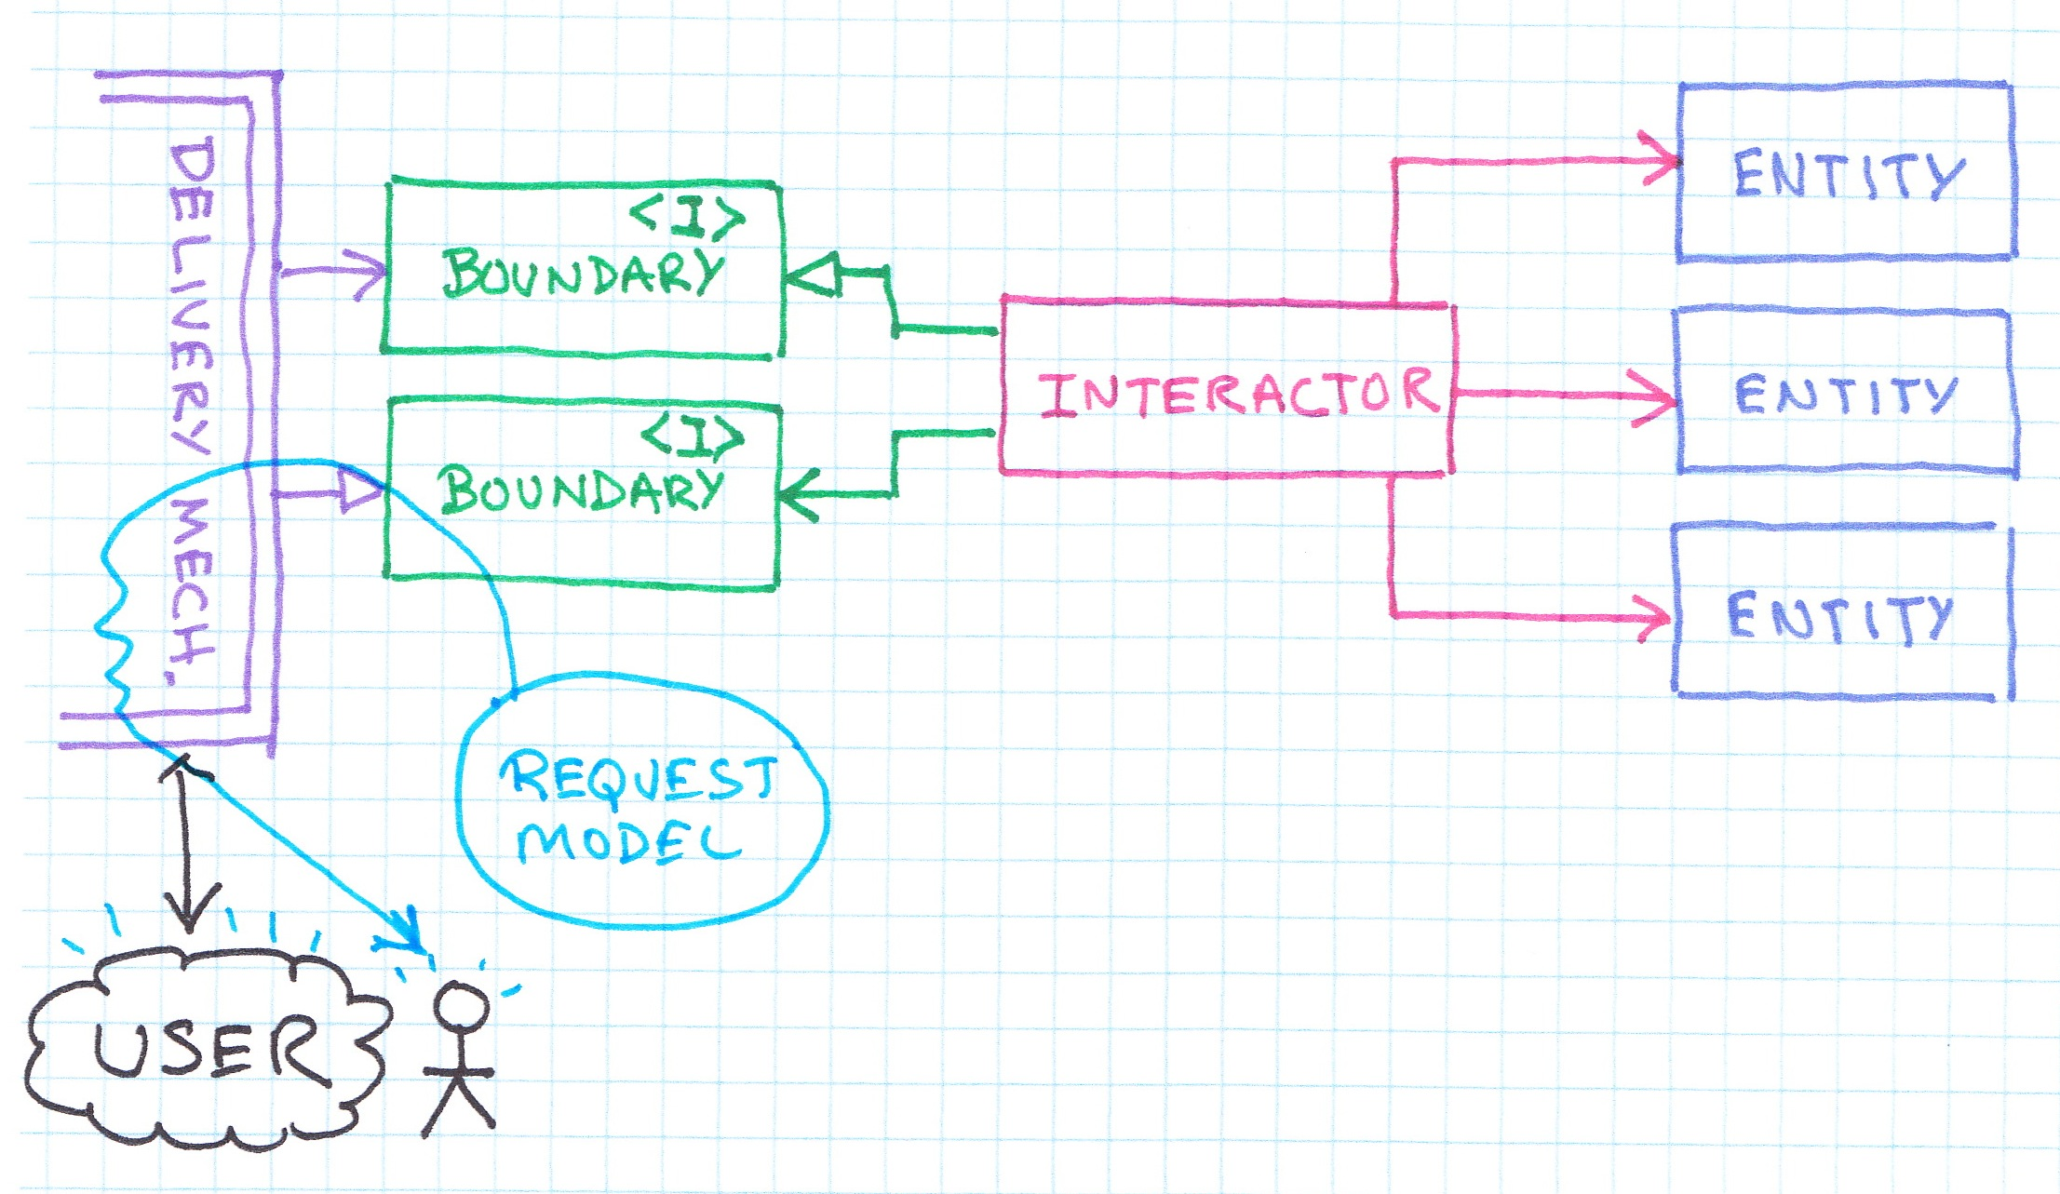
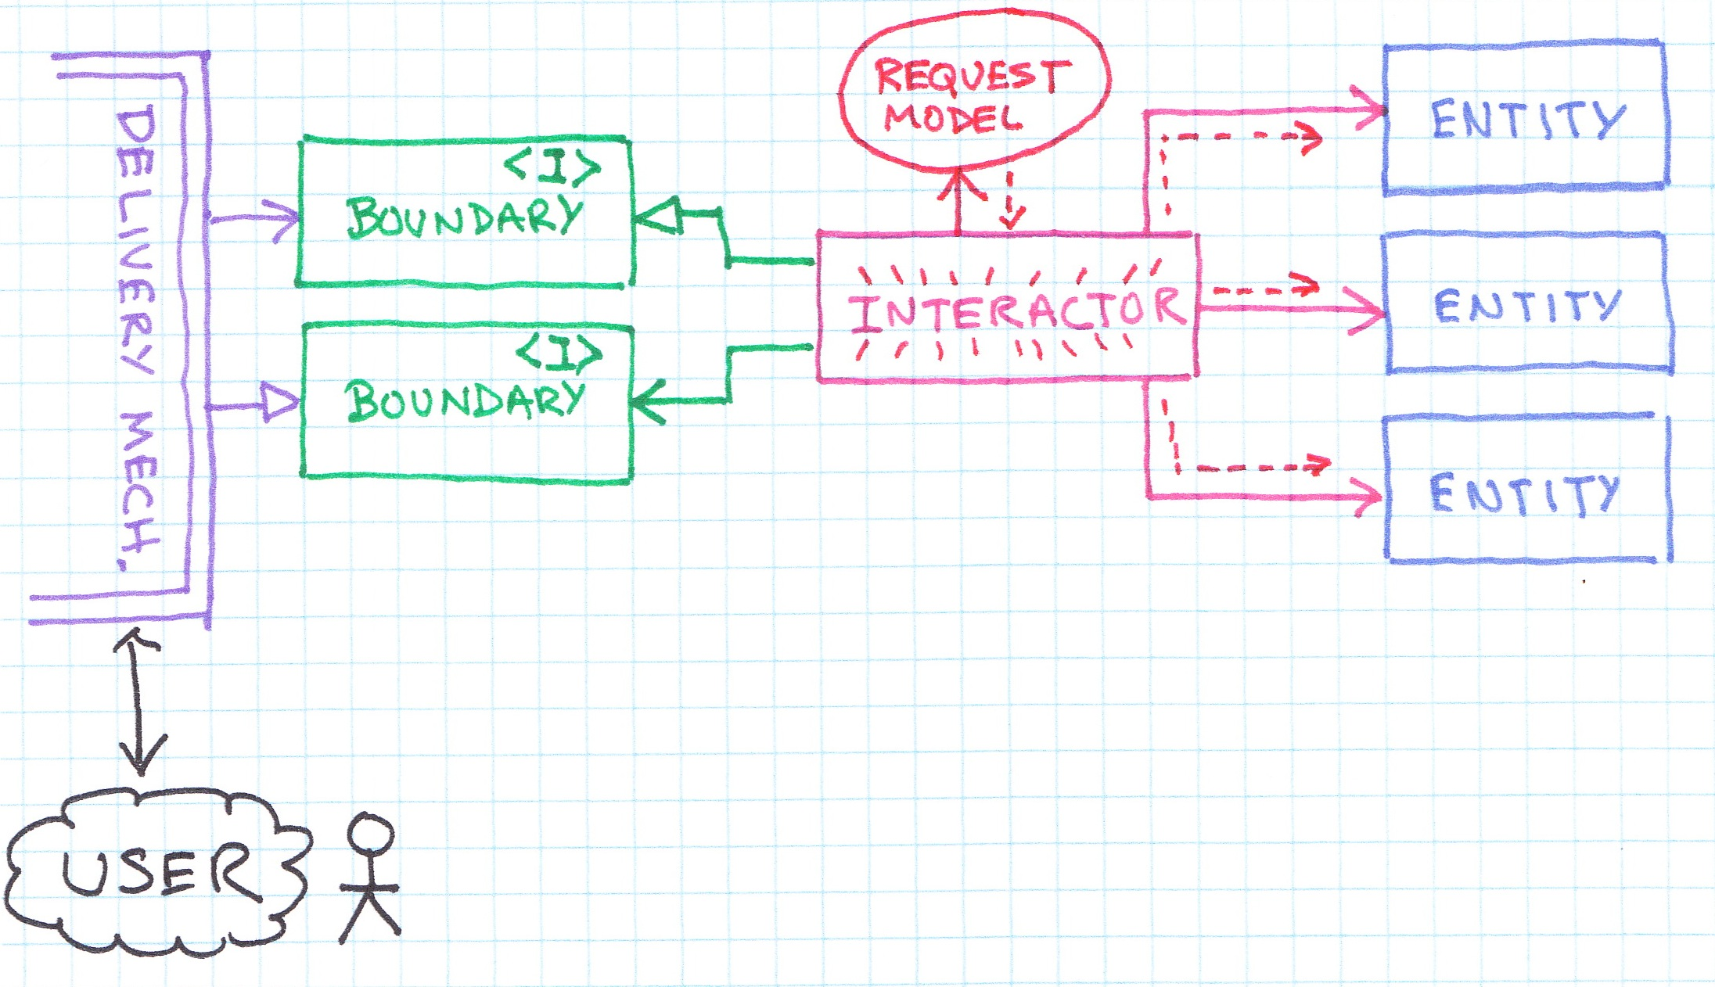
Web MVC

